Slide 1



Idiomatic Programmer Learning Keras
Computer Vision Workshop Version: July 2019

Slide 2
Idiomatic Programmer Learning Keras
Repo: github.com/GoogleCloudPlatform/keras-idiomatic-programmer
Workshops, Handbooks, and Model Zoo

Slide 3
Wide Convolutional Neural Networks
Wide Layers
Starting in 2014 with Inception v1 (GoogleNet) and 2015 with ResNeXt (Microsoft Research) and Inception v2, neural network designs moved into wide layers (vs. deeper layers). Essentially, a wide layer is having multiple convolutions in parallel and then concatenating their outputs.
The GoogLeNet (Inception v1) won the 2014 ImageNet contest and introduced the ‘inception module”. The inception module is a convolutional layer with parallel convolutions of different sizes, with the outputs concatenated together. The principle behind it was that instead of trying to pick the best filter size for a layer, each layer has multiple filter sizes in parallel, and the layer learns which size is the best.

Slide 4
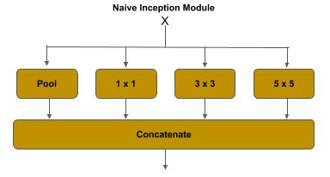
Wide CNN - Naive Inception Module
Naive Inception Module
The figure below shows the naive inception module, which demonstrates the principle behind the inception module. In a conventional convolution block, the output from the convolution layer is passed through a pooling layer for dimensionality reduction. The output from a previous convolution layer is branched.
One branch is passed through a pooling layer for dimensionality reduction, as in a conventional convolutional layer,
and the remaining branches are passed through convolution layers of different sizes (i.e., 1x1, 3x3, 5x5).
The outputs from the pooling and the other convolution layers are then concatenated together.

Slide 5
Wide CNN - Naive Inception Module
Naive Inception Module - Filters
The different filter sizes capture different levels of detail. The 1x1 convolution captures fine details of features, while the 5x5 captures more abstract features. The code below demonstrates a naive inception module. The input from a previous layer x is branched and passed through:
max pooling layer,
1x1, 3x3 and 5x5 convolution
then concatenated together.
# The inception branches (where x is the previous layer) x1 = layers.MaxPooling2D((3, 3), strides=(1,1), padding='same')(x) x2 = layers.Conv2D(64, (1, 1), strides=(1, 1), padding='same')(x) x3 = layers.Conv2D(96, (3, 3), strides=(1, 1), padding='same')(x) x4 = layers.Conv2D(48, (5, 5), strides=(1, 1), padding='same')(x) # concatenate the filters x = layers.concatenate([x1, x2, x3, x4])

Slide 6
Wide CNN - Naive Inception Module
Naive Inception Module - Padding
By setting padding=’same’, the height and width dimensions are preserved. This allows concatenating the filters together. For example, if the above the input to this layer was 28x28x256, the dimensions at the branch layers would be:
x1 (pool) : (?, 28, 28, 256)
x2 (1x1) : (?, 28, 28, 64)
x2 (3x3) : (?, 28, 28, 96)
x3 (5x5) : (?, 28, 28, 48)
After the concatenation, the output would be:
x (concat) : (?, 28, 28, 464) # 256 + 64 + 96 + 48

Slide 7
Wide CNN - Naive Inception Module
Naive Inception Module - Padding
If the padding=’same’ argument is left out (defaults to padding=’valid’), the shapes would be instead:
x1 (pool) : (?, 26, 26, 256)
x2 (1x1) : (?, 28, 28, 64)
x2 (3x3) : (?, 26, 26, 96)
x3 (5x5) : (?, 24, 24, 48)
Since the width and height dimensions do not match, if one tried to concatenate these layers, one would get an error:
ValueError: A Concatenate layer requires inputs with matching shapes except for the concat axis. Got inputs shapes: [(None, 26, 26, 256), (None, 28, 28, 64), (None, 26, 26, 96), (None, 24, 24, 48)]

Slide 8
Wide CNN - Naive Inception Module
Naive Inception Module - Parameters
A summary() for these layers shows 544K parameters to train.
max_pooling2d_161 (MaxPooling2D (None, 28, 28, 256) 0 input_152[0][0] __________________________________________________________________________________________________ conv2d_13130 (Conv2D) (None, 28, 28, 64) 16448 input_152[0][0] __________________________________________________________________________________________________ conv2d_13131 (Conv2D) (None, 28, 28, 96) 221280 input_152[0][0] __________________________________________________________________________________________________ conv2d_13132 (Conv2D) (None, 28, 28, 48) 307248 input_152[0][0] __________________________________________________________________________________________________ concatenate_429 (Concatenate) (None, 28, 28, 464) 0 max_pooling2d_161[0][0] conv2d_13130[0][0] conv2d_13131[0][0] conv2d_13132[0][0] ================================================================================================== Total params: 544,976 Trainable params: 544,976

Slide 9
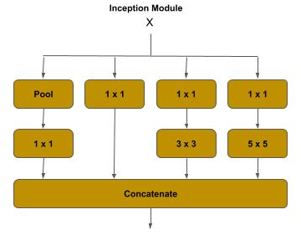
Wide CNN - Inception v1
Inception v1 - Dimensionality Reduction
In the GoogLeNet, a further dimensionality reduction was introduced by adding a 1x1 convolution (bottleneck) to the pooling, 3x3 and 5x5 branches. This dimension reduction reduced the overall computational complexity by nearly ⅔.

Slide 10
Wide CNN - Inception v1
Inception v1 - Dimensionality Reduction
Below is an example of an Inception v1 module:.
# The inception branches (where x is the previous layer) x1 = layers.MaxPooling2D((3, 3), strides=(1,1), padding='same')(x) x1 = layers.Conv2D(64, (1, 1), strides=(1, 1), padding='same')(x1) x2 = layers.Conv2D(64, (1, 1), strides=(1, 1), padding='same')(x) # passes straight through x3 = layers.Conv2D(64, (1, 1), strides=(1, 1), padding='same')(x) x3 = layers.Conv2D(96, (3, 3), strides=(1, 1), padding='same')(x3) x4 = layers.Conv2D(64, (1, 1), strides=(1, 1), padding='same')(x) x4 = layers.Conv2D(48, (5, 5), strides=(1, 1), padding='same')(x4) # concatenate the filters x = layers.concatenate([x1, x2, x3, x4])

Slide 11
Wide CNN - Inception v1
Inception v1 - Parameters
A summary() for these layers shows 198K parameters to train.
max_pooling2d_162 (MaxPooling2D (None, 28, 28, 256) 0 input_153[0][0] __________________________________________________________________________________________________ conv2d_13135 (Conv2D) (None, 28, 28, 64) 16448 input_153[0][0] __________________________________________________________________________________________________ conv2d_13137 (Conv2D) (None, 28, 28, 64) 16448 input_153[0][0] __________________________________________________________________________________________________ conv2d_13133 (Conv2D) (None, 28, 28, 64) 16448 max_pooling2d_162[0][0] __________________________________________________________________________________________________ conv2d_13134 (Conv2D) (None, 28, 28, 64) 16448 input_153[0][0] __________________________________________________________________________________________________ conv2d_13136 (Conv2D) (None, 28, 28, 96) 55392 conv2d_13135[0][0] __________________________________________________________________________________________________ conv2d_13138 (Conv2D) (None, 28, 28, 48) 76848 conv2d_13137[0][0] __________________________________________________________________________________________________ concatenate_430 (Concatenate) (None, 28, 28, 272) 0 conv2d_13133[0][0] conv2d_13134[0][0] conv2d_13136[0][0] conv2d_13138[0][0] ================================================================================================== Total params: 198,032 Trainable params: 198,032

Slide 12
Wide CNN - Inception v1
Inception v1 - Architecture
GoogLeNet consists of four groups:
Stem Convolutional Group :
This is the entry point into the neural network. The inputs (images) are processed
by a sequential (deep) set of convolutions and max pooling, much like a conventional ConvNet. Wide Convolutional Group : This is a set of seven inception blocks in five groups. The wider blocks in the diagram represent a group of two or three inception blocks, and the thinner ones are a single inception block, for a total of nine inception blocks. The fourth and seventh block (single blocks) are separated out to highlight they have an additional component, referred to as the auxiliary classifier.
Auxiliary Classifiers Group : This is a set of two classifiers, acting as auxiliary (aids) in training the neural network, each consisting of a convolutional layer, a dense layer and a final softmax activation function.
Classifier Group This is a single and final classifier in both training the neural network and in prediction (inference).

Slide 13
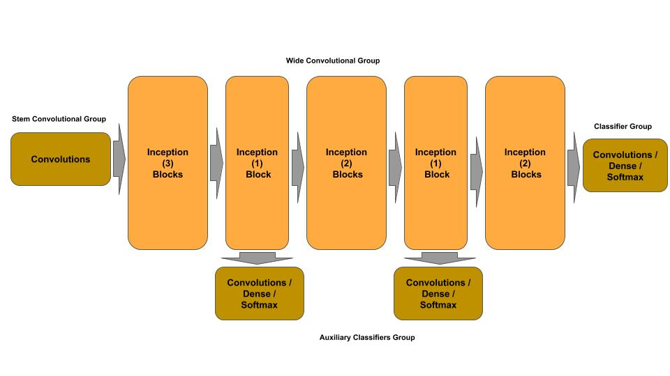
Wide CNN - Inception v1
Inception v1 - Auxiliary Classifiers
The GoogleLeNet architecture introduced the concept of an auxiliary classifier. The principle here is that as a neural network gets deeper in layers (i.e., the front layers get further away from the final classifier) the front layers are more exposed to a vanishing gradient and increased time (e.g., number of epochs) to train the weights in the front most layers.

Slide 14
Wide CNN - ResNeXt
Residual Wide Convolutional Neural Networks
ResNeXt (Microsoft Research) was the winner of the 2015 ImageNet competition and introduced the concept of a wide residual (block) neural network and cardinality (i.e., width). This architecture uses a split, branch and merge method of parallel convolutional blocks. The number of parallel convolutional blocks (i.e., width) is referred to as the cardinality. For example, in the 2015 competition, the ResNeXt architecture used a cardinality of 32, meaning each ResneXt layer consisted of 32 parallel convolutional blocks.
At each ResNeXt layer:
The input from the previous layer is split across the parallel convolutional blocks,
and the output (feature maps) from each convolutional block is concatenated,
and finally the input to the layer is matrix added to the concatenated output (identity link) to form the residual block.

Slide 15
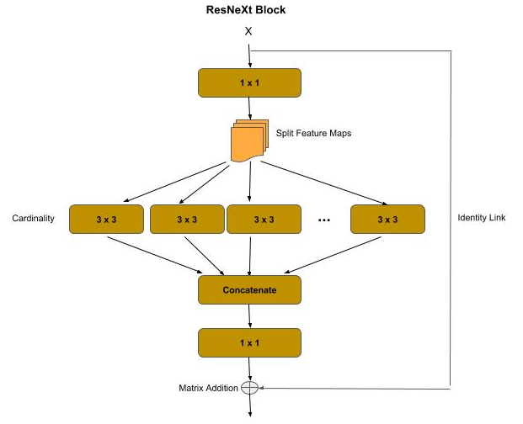
Wide CNN - ResNeXt
ResNeXt Blocks
The wide residual block group consists of:
A first bottleneck convolution ( 1 x 1 kernel )
A split-branch-concatenate convolution of a cardinality N
A final bottleneck convolution ( 1 x 1 kernel )
An identity link between the input and the final
convolution output

Slide 16
Wide CNN - ResNeXt
ResNeXt Blocks - Splitting / Cardinality
The first bottleneck convolution performs a dimensionality reduction (feature pooling), similar to its use in a residual block or inception module. After the bottleneck convolution:
The feature maps are split among the parallel convolutions according to the cardinality. For example, if the number of feature maps (filters) is 128 and the cardinality is 32, then each parallel convolution will get 4 feature maps (128 / 32).
The outputs from the parallel convolutions are then concatenated back into a full set of feature maps, which are then passed through a final bottleneck convolution for another dimensionality reduction (feature pooling).
As in the residual block, there is an identity link between the input to and output from the resnext block, which is then matrix added.

Slide 17
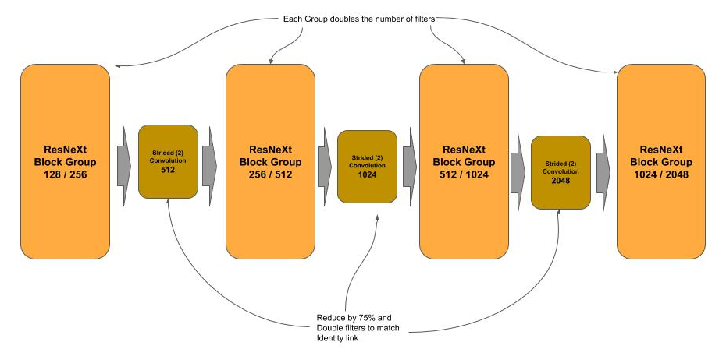
Wide CNN - ResNeXt
ResNeXt Blocks - Architecture
The ResNeXt-50 architecture starts with a stem convolution block for the input, which consists of a 7 x 7 convolution which is then passed through a max pooling layer for reducing the data.
Following the stem are four groups of resnext blocks. Each group progressively doubles the number of filters outputted vs. the input. Between each block is a strided convolution, which serve two purposes (reduces data by 75% [feature pooling], and doubles the filters from the output of the previous layer, to match the identity link.

Slide 18
Wide CNN - ResNeXt Block
def _resnext_block(shortcut, filters_in, filters_out, cardinality=32): # Bottleneck layer x = layers.Conv2D(filters_in, kernel_size=(1, 1), strides=(1, 1), padding='same')(shortcut) x = layers.BatchNormalization()(x) x = layers.ReLU()(x) # Cardinality (Wide) Layer filters_card = filters_in // cardinality groups = [] for i in range(cardinality): group = layers.Lambda(lambda z: z[:, :, :, i * filters_card:i * filters_card + filters_card])(x) groups.append(layers.Conv2D(filters_card, kernel_size=(3, 3), strides=(1, 1), padding='same')(group)) # Concatenate the outputs of the cardinality layer together x = layers.concatenate(groups) x = layers.BatchNormalization()(x) x = layers.ReLU()(x) # Bottleneck layer x = layers.Conv2D(filters_out, kernel_size=(1, 1), strides=(1, 1), padding='same')(x) x = layers.BatchNormalization()(x) # Identity Link: Add the shortcut (input) to the output of the block x = layers.add([shortcut, x]) x = layers.ReLU()(x) return x

Slide 19
Wide CNN - Stem & Strided Convolution
Stem Group & Strided Convolution between ResNeXt Groups
# The input tensor inputs = layers.Input(shape=(224, 224, 3)) # Stem Convolutional layer x = layers.Conv2D(64, kernel_size=(7, 7), strides=(2, 2), padding='same')(inputs) x = layers.BatchNormalization()(x) x = layers.ReLU()(x) x = layers.MaxPool2D(pool_size=(3, 3), strides=(2, 2), padding='same')(x) # First ResNeXt Group for _ in range(3): x = _resnext_block(x, 128, 256) # strided convolution to match the number of output filters on next block and reduce by 2 x = layers.Conv2D(512, kernel_size=(1, 1), strides=(2, 2), padding='same')(x) # Second ResNeXt Group for _ in range(4): x = _resnext_block(x, 256, 512)

Slide 20
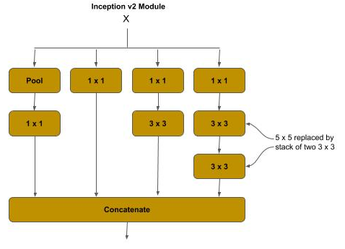
Wide CNN - Inception V2
Factorization
Inception v2 introduced the concept of factorization for the more expensive convolutions in an inception module to reduce computational complexity, and reduce information loss from representational bottlenecks.
The larger a filter (kernel) size is in a convolution, the more computationally expensive it is. The paper which presented the Inception v2 architecture calculated that the 5 x 5 convolution in the inception module was 2.78x more computationally expensive than a 3 x 3. In the Inception v2 module, the 5 x 5 filter is replaced by a stack of two 3 x 3 filters, which results in a reduction of computational complexity of the replaced 5 x 5 filter by 33%.

Slide 21
Wide CNN - Inception V2
Inception V2 Module
A summary() for these layers shows 169K parameters to train, when compared to 198K for the inception v1 module.
# The inception branches (where x is the previous layer) x1 = layers.MaxPooling2D((3, 3), strides=(1,1), padding='same')(x) x1 = layers.Conv2D(64, (1, 1), strides=(1, 1), padding='same')(x1) x2 = layers.Conv2D(64, (1, 1), strides=(1, 1), padding='same')(x) # pass straight thru x3 = layers.Conv2D(64, (1, 1), strides=(1, 1), padding='same')(x) x3 = layers.Conv2D(96, (3, 3), strides=(1, 1), padding='same')(x3) x4 = layers.Conv2D(64, (1, 1), strides=(1, 1), padding='same')(x) x4 = layers.Conv2D(48, (3, 3), strides=(1, 1), padding='same')(x4) # 5x5 is replaced by two 3x3 x4 = layers.Conv2D(48, (3, 3), strides=(1, 1), padding='same')(x4) # concatenate the filters x = layers.concatenate([x1, x2, x3, x4])

Slide 22
Wide CNN - Inception V3
Stem Factorization
The Inception v3 architecture primarily made updates to improve the auxiliary classifiers, and additionally, the 7 x 7 convolution in the stem convolution group was factorized and replaced by a stack of three 3 x 3 convolutions, where:
The first 3 x 3 is a strided convolution (strides=2, 2) which performs a feature pooling.
The second 3 x 3 is a regular convolution.
The third 3 x 3 doubles the number of filters.
# Inception v3 stem, 7 x 7 is replaced by a stack of 3 x 3 convolutions. x = layers.Conv2D(32, (3, 3), strides=(2, 2), padding='same')(input) x = layers.Conv2D(32, (3, 3), strides=(1, 1), padding='same')(x) x = layers.Conv2D(64, (3, 3), strides=(1, 1), padding='same')(x) # max pooling layer x = layers.MaxPooling2D((3, 3), strides=(2, 2), padding='same')(x) # bottleneck convolution x = layers.Conv2D(80, (1, 1), strides=(1, 1), padding='same')(x) # next convolution layer x = layers.Conv2D(192, (3, 3), strides=(1, 1), padding='same')(x) # strided convolution - feature map reduction x = layers.Conv2D(256, (3, 3), strides=(2, 2), padding='same')(x)

Slide 23
Wide CNN - Inception V4
Further Stem Factorization
The Inception v4 architecture made additional improvements to the stem convolution group to reduce computational complexity by introducing reduction blocks (which appear to be a variation of a residual block). In a reduction block, the input is branched and then merged with a concatenation operation.
The max pooling layer is replaced with a reduction block.
A max pooling layer
A 3 x 3 strided convolution
The bottleneck and second convolution layer are replaced with a variation of a reduction block.
The bottleneck convolution is reduced from size (from 80 to 64) and stacked with a 3 x 3 convolution.
The second convolution layer is replaced with a stack of 1 x 1 bottleneck, a nx1 and 1xn pair and a 3 x 3 convolution.
The final strided convolution is replaced with a reduction block.
A max pooling layer
A 3 x 3 strided convolution

Slide 24
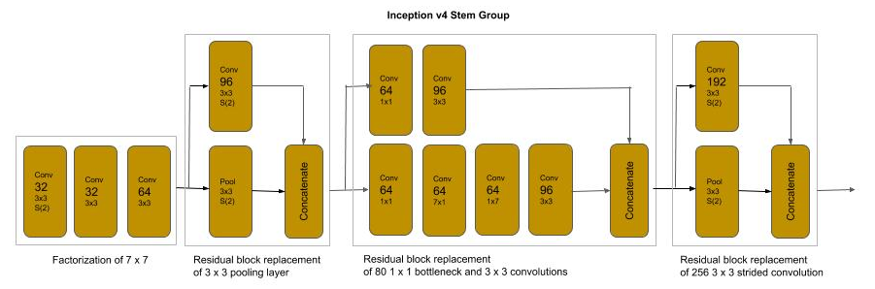
Wide CNN - Inception V4
Stem Architecture
A summary() for the stem group shows 426K parameters to train with input (229, 229, 3) vs. the 614K for the Inception v3 stem group.

Slide 25
Wide CNN - Inception V4
# Inception v4 stem, 7 x 7 is replaced by a stack of 3 x 3 convolutions. x = layers.Conv2D(32, (3, 3), strides=(2, 2), padding='same')(inputs) x = layers.Conv2D(32, (3, 3), strides=(1, 1), padding='same')(x) x = layers.Conv2D(64, (3, 3), strides=(1, 1), padding='same')(x) # max pooling is replaced by reduction block of max pooling and strided convolution bpool = layers.MaxPooling2D((3, 3), strides=(2, 2), padding='same')(x) b3x3 = layers.Conv2D(96, (3, 3), strides=(2, 2), padding='same')(x) x = layers.concatenate([bpool, b3x3]) # bottleneck and 3x3 convolution replaced by reduction block bnxn = layers.Conv2D(64, (1, 1), strides=(1, 1), padding='same')(x) bnxn = layers.Conv2D(64, (7, 1), strides=(1, 1), padding='same')(bnxn) bnxn = layers.Conv2D(64, (1, 7), strides=(1, 1), padding='same')(bnxn) bnxn = layers.Conv2D(96, (3, 3), strides=(1, 1), padding='same')(bnxn) b3x3 = layers.Conv2D(64, (1, 1), strides=(1, 1), padding='same')(x) bnxn = layers.Conv2D(96, (3, 3), strides=(1, 1), padding='same')(b3x3) x = layers.concatenate([bnxn, b3x3]) # 3x3 strided convolution replaced by reduction block bpool = layers.MaxPooling2D((3, 3), strides=(2, 2), padding='same')(x) b3x3 = layers.Conv2D(192, (3, 3), strides=(2, 2), padding='same')(x) x = layers.concatenate([bpool, b3x3])

Slide 26
Wide CNN - Code Lab #3
Optional Code Lab - Get Familiar with Wide Convolutional Neural Networks
Idiomatic Programmer - handbook 1 - Codelab 3.ipynb

